Slide 1
Secure Data Hiding in Image Using Steganography
Presented By:
Student Name : Avi Upadhyay
College Name & Department : VIT Vellore, CSE (spe. Cybersecurity)

Slide 2
OUTLINE
Problem Statement
Technology used
Wow factor
End users
Result
Conclusion
Git-hub Link
Future scope

Slide 3
Problem Statement
To develop a steganographic method to securely hide data within digital images. This system will ensure the integrity and confidentiality of hidden data while maintaining the image quality, making it imperceptible to human observers and difficult for unauthorized parties to detect. The project will evaluate various steganographic techniques and implement the most suitable method for secure data embedding.

Slide 4
Technology used
Windows 10+
IDLE Python Editor
Libraries:
cv2
Os
String

Slide 5
Wow factors
The project’s steganographic method not only securely embeds data within digital images, making it invisible to the human eye, but also ensures robust encryption and integrity. By leveraging advanced algorithms, this system can resist detection even by sophisticated analysis techniques, offering a revolutionary way to protect sensitive information in plain sight without compromising image quality.

Slide 6
End users
Journalists and Whistleblowers
Government Agencies
Corporate Sector
Law Enforcement
General Public

Slide 7

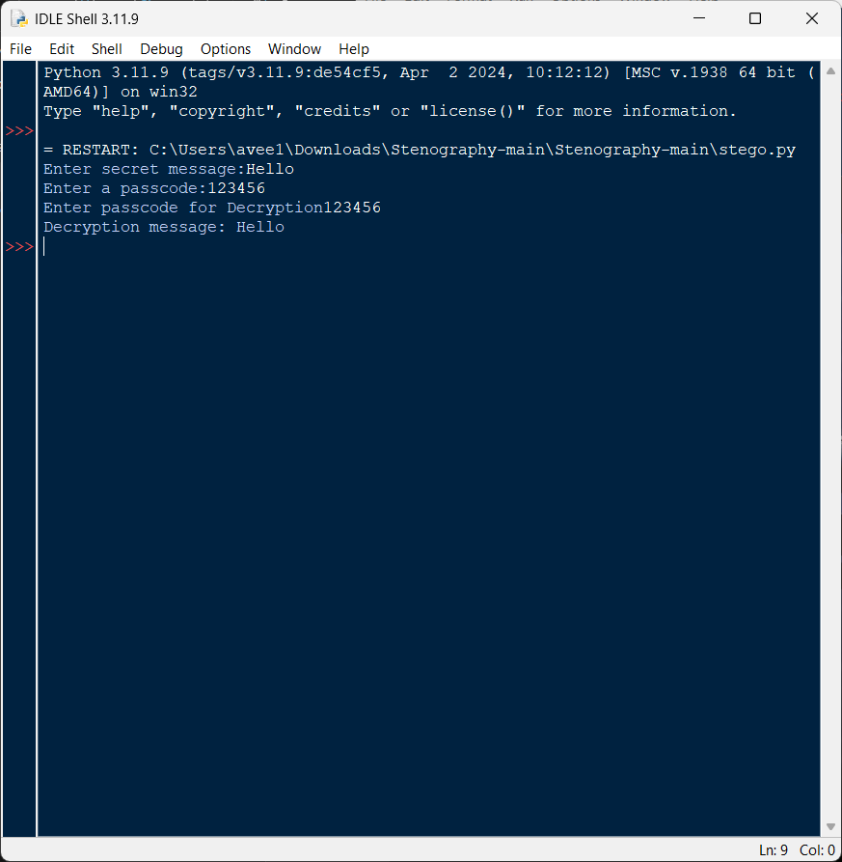
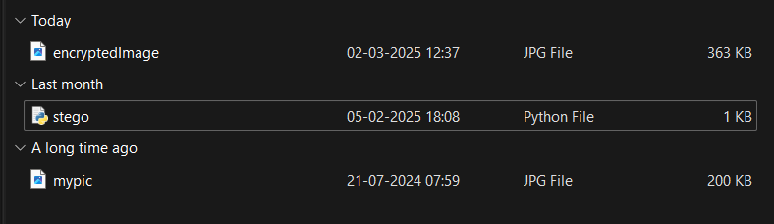
Results

Slide 8
Conclusion
The steganographic method developed in this project provides a secure way to embed data within digital images. This innovative solution ensures the confidentiality and integrity of sensitive information while maintaining image quality. It empowers a diverse range of end users, from journalists to the general public, by enhancing data security in our digital world.

Slide 9
GitHub Link
https://github.com/AveeUpd/ibm_skills_build_project.git

Slide 10
THANK YOU

